Slide 1
Content producing strategy for NETFLIX to increase user engagement Final Project
Team:
Jugal Shah
Kalyan Dhar
Prasad Yacham
Summer 2022, Data Visualization
INDIANA UNIVERSITY

Slide 2



Project Team
Jugal Shah
Kalyan Dhar
Prasad Yacham

Slide 3
Introduction
Section 1

Slide 4
Introduction and Objective
NETFLIX – Online Movie Subscription Rental Company
Analysis of current content on Netflix
Netflix digital content analysis and user engagement level
Review existing work and provide unique contributions to it
Providing business insights for better content producing strategy to improve revenue

Slide 5
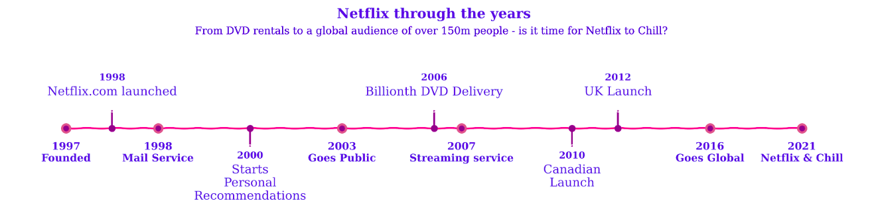
Motivation
NETFLIX – Pioneer in digital streaming industry
Started its Journey as DVD Rental company
2007 – Start of Streaming Service → 2021 – Becomes internationally streaming Giant

Slide 6
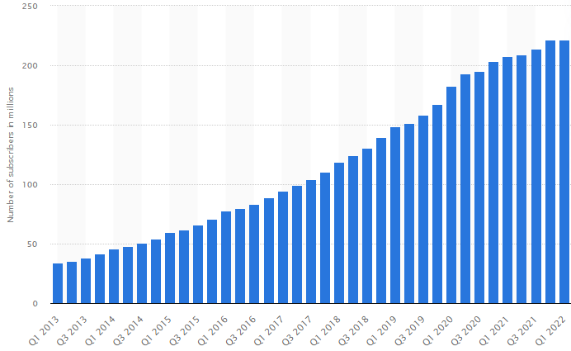
Motivation
Increasing competition in digital streaming world
NETFLIX subscriber counts – 222 Millions
Next best Amazon Prime - ~200 Million Subs
NETFLIX gained subscribers quickly in early years
Completion hindered subscriber growth

Slide 7
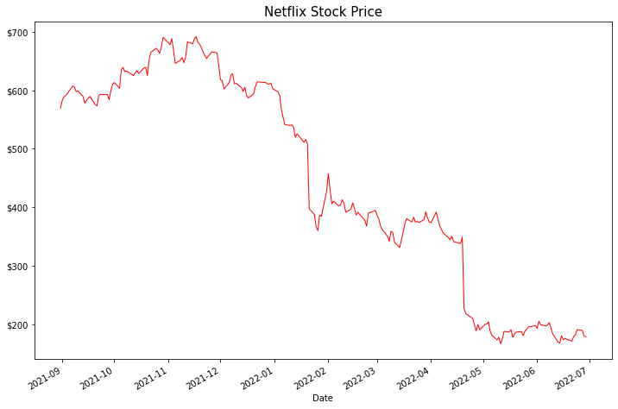

Motivation
NETFLIX stock price dropped recently
Stock dropped from ~$600 to ~$200 in span of 9 months
Netflix admitted they are losing subscribers
Primary reason –
increasing competition
More choices for users
Decreased User Engagement
Proper content strategy can help NETFLIX to increase user engagement and improve revenue.

Slide 8
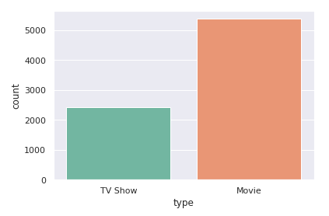
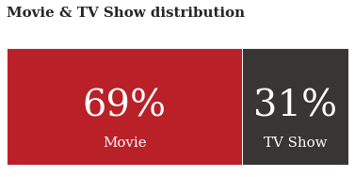
Review of Existing Work
EXISTING VISUALIZATION
Several existing visualization reviewed
Some visualization ineffectively use colors
Many visualization does not consider to improve data ink ratio
Example on right side does not give much insights
Improved visualization shows beautifully distribution of content types on Netflix
IMPROVED VISUALIZATION

Slide 9
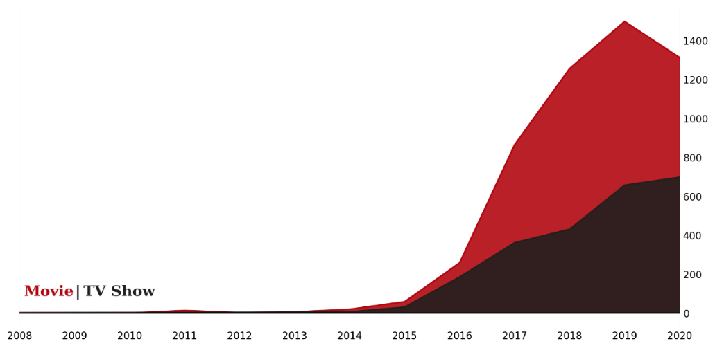
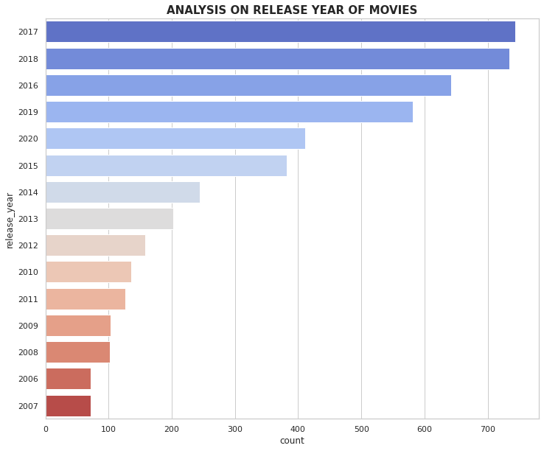
Review of Existing Work
IMPROVED VISUALIZATION
EXISTING VISUALIZATION
Bar chart is not a right way to represent time series Plot
Existing visualization uses colors unnecessarily
Does not give information between content types
Line chart is most appropriate

Slide 10
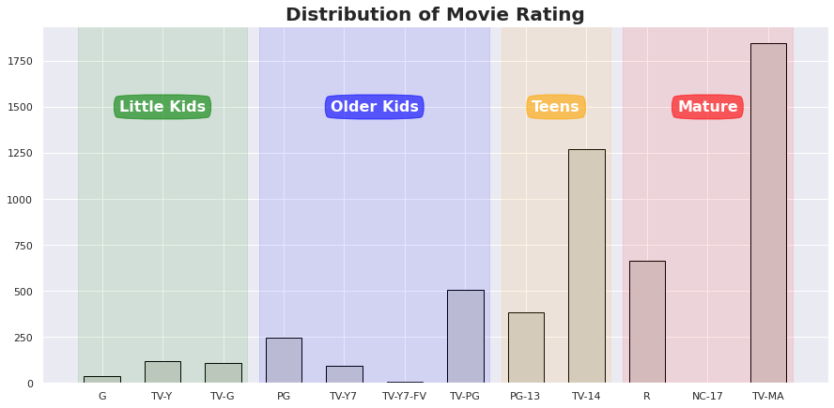
Review of Existing Work
EXISTING VISUALIZATION
Visualization on right shows distribution of content by age group
Each Age group colored separately
Within each rating content is distributed by ratings
Beautifully shows potential untapped market
Netflix lacks in engaging Kids and Older Kids

Slide 11
Contribution to existing work
Use of Geographic data to provide region specific content strategy
Heatmap between countries and targeted age group
Analyzing content addition growth rate
Correlation between content genres
Connecting with IMDB database to identify top categories by regions

Slide 12
Dataset and Design Methodology
Section 2

Slide 13
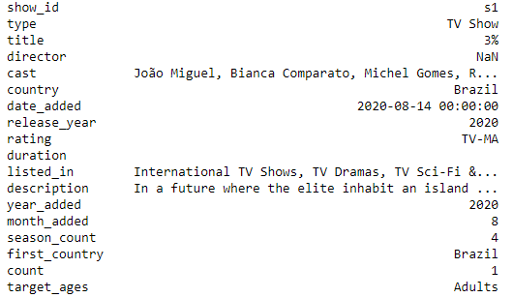
About the Dataset
Publicly available on Kaggle
8000+ content details
It contains information as of May-2021
Contains listing of all movies and TV show available
Content specific details such as cast, country of origin, duration etc.
Date time functions such as release year and content addition time
Description can be used to generate Wordcloud
Some data like genres can be obtained from IMDB movie dataset
Example of one of the record

Slide 14
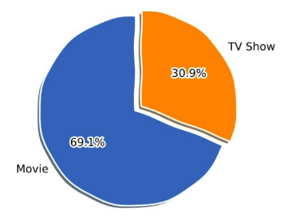
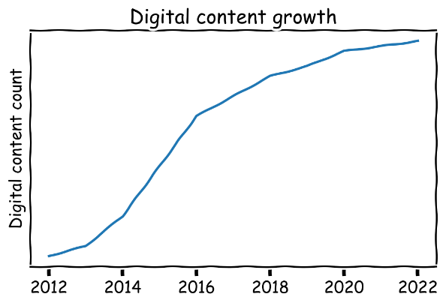
Ideas and Sketches
Dataset contains both Numerical and Categorical columns
Content release and addition date represent time series
Data can be visualized across different categories using slicing and dicing
Timeseries plot can help to identify trend and growth rate
Using Choropleth, top countries and their preference can be visualized

Slide 15
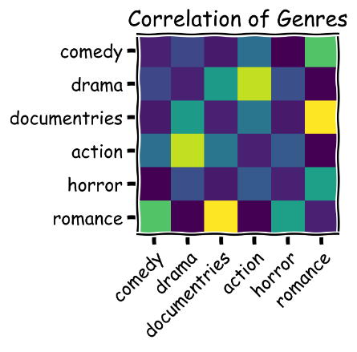
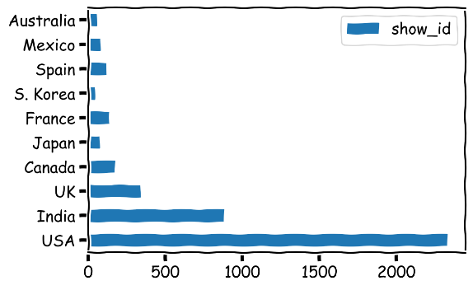
Ideas and Sketches
Correlation between different features can be visualized using heatmap
Also, heatmap can be used to visualize crosstabs across two categories for example, target age group and countries
Pie Chart is not good for large number of categories
Simple bar chart can help us to visualize distribution across different categories

Slide 16
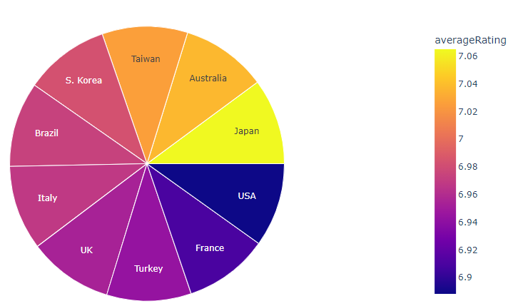
Visualization Process and Methodology
Several Iterations performed
None of existing visualization merged with IMDB dataset
IMDB provides quality index for movies and TV-shows
Selected only countries with 100+ titles on Netflix
US ranks bottom 10(Avg rating 6.9) on Netflix
Not all content rating available on IMDB
Good visualization, however, not insightful

Slide 17
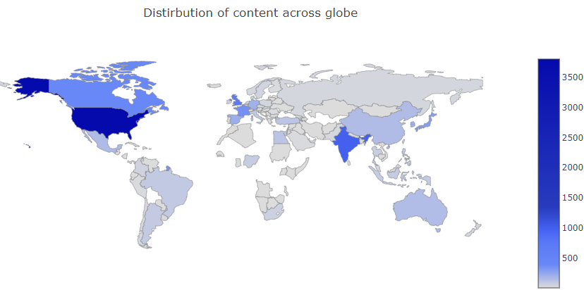
Map vs Bar Chart
Choropleth map visualization shows content distribution across countries
It gives general Idea
USA, INDIA and Canada ranks among top content producer
Only one variable can be visualized at the time
Without country label hard for people with no geographical knowledge
Choropleth Map does not provide all information

Slide 18
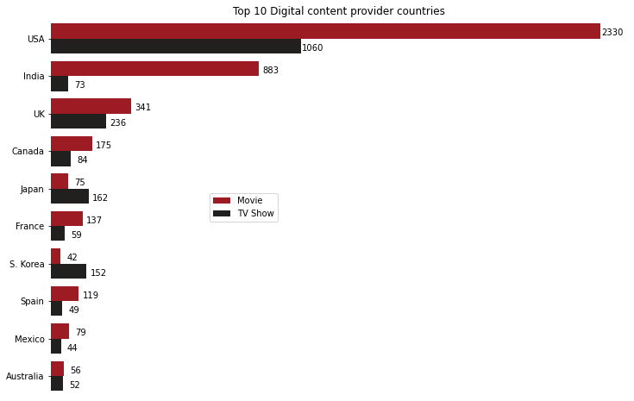
Map vs Bar Chart
Choropleth map visualization is not good for all cases
Simple bar chart can solve that problem
It can compare multiple variable across different categories
Proper data label provides more information using less ink
Japan and S. Korea has more TV-shows then Movies
Choropleth did not reveal this information
Easy to read and interpret

Slide 19
Result and Business Insight
Section 3

Slide 20
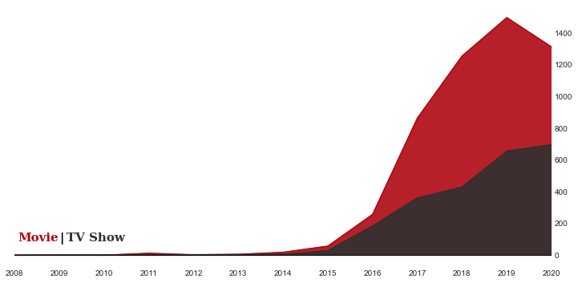
Growth of Digital Content
Start of Digital Streaming – 2007
Netflix Started Adding more content 2014 onwards
Drop of content addition in 2020 (Possible Pandemic Effect)
More movies added then TV show
Overall, 69% content is movies

Slide 21
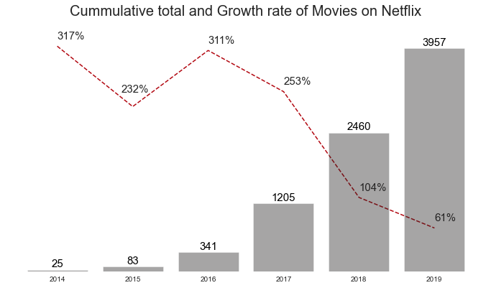
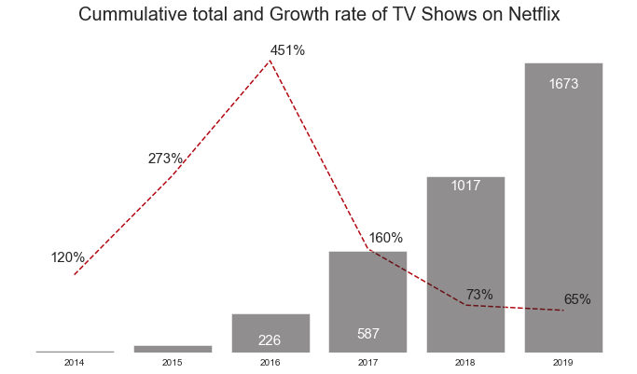
Growth Rate Analysis
Netflix constantly adds new content every year, Growth rate is dropping
However, they are still adding more than 50% of new content every year
More streaming platform and increasing competition
Netflix is pressured to produce its own contents

Slide 22
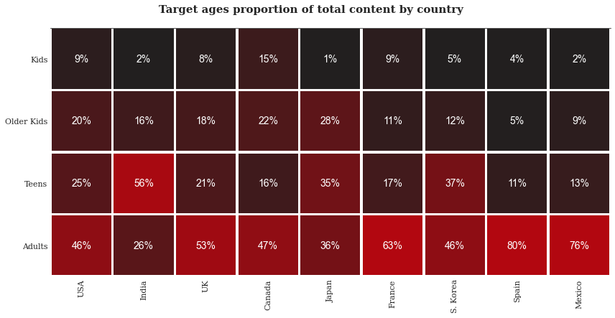
Which Age group Netflix should targe?
Tailor made content for each geographic region is necessary
For Most countries content related to adult age group dominates
Top 10 countries have content related to kid less than 15%
Potential Market Opportunity
Produce more kids related content

Slide 23
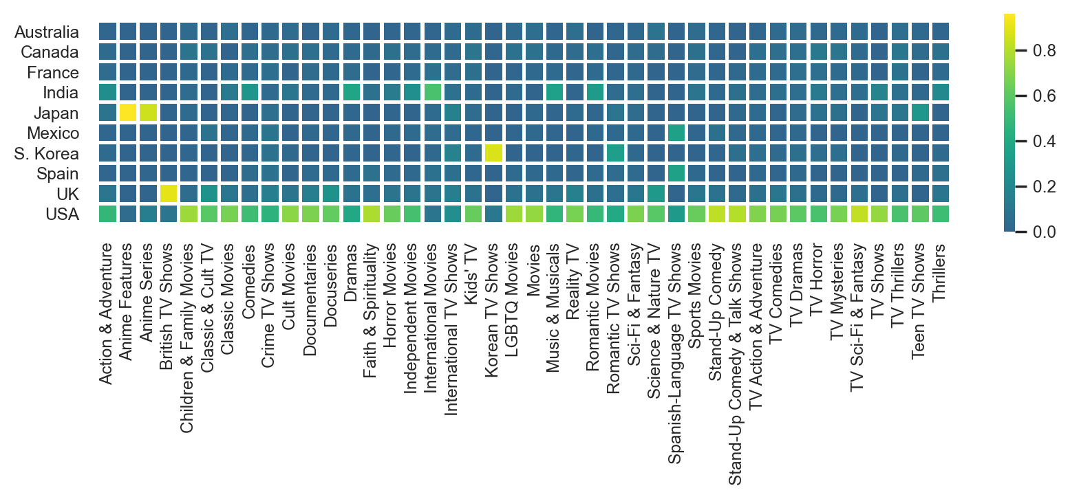
Which Genres Netflix should target?
Heatmap of Countries and Content Genres
Japan has more Anime movies and TV-shows
Britain and S. Korea prefers local contents more
Most international movies are from India
Netflix should provide contents based on region specific needs

Slide 24
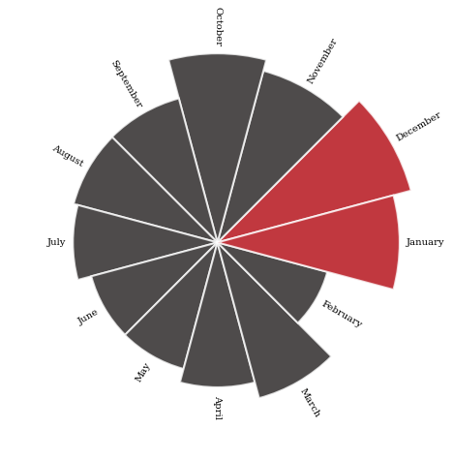
Which is the best month to add New Content?
Seasonal analysis provides demand based on different months
It is important to add right content at right time
Month of December and January tends to have higher number of contents
Typically, December and January are holiday months

Slide 25
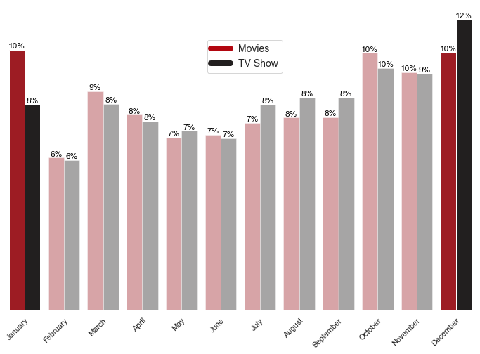
Which is the best month to add New Content?
Distribution of movies and TV-shows across different months
More TV-shoes added in December than any other months
Overall, ideal months to add contents are December and January
More holidays are in December, hence ideal to release new TV-shows

Slide 26
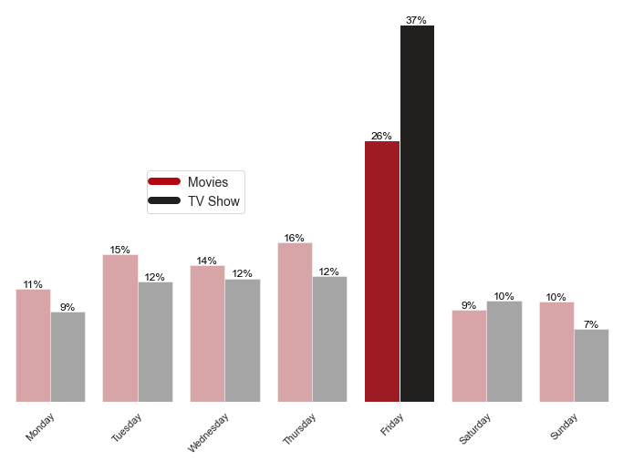
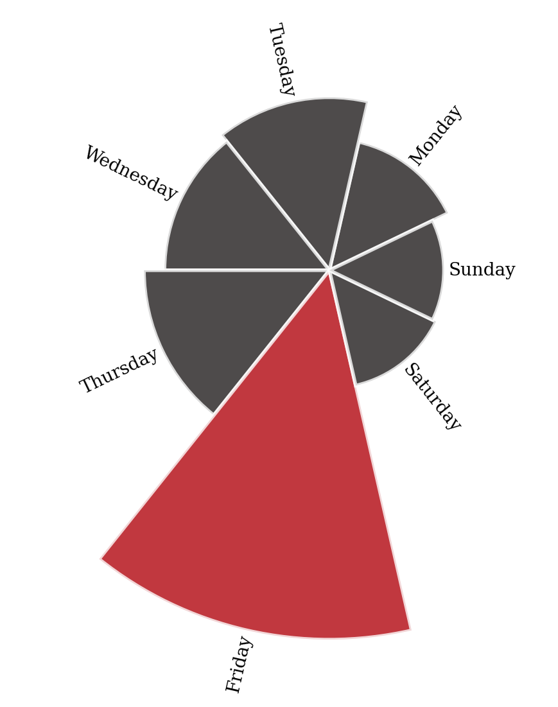
Which is the best day to add New Content?
Friday is most optimal day to release new contents
More people can be engaged over weekend

Slide 27
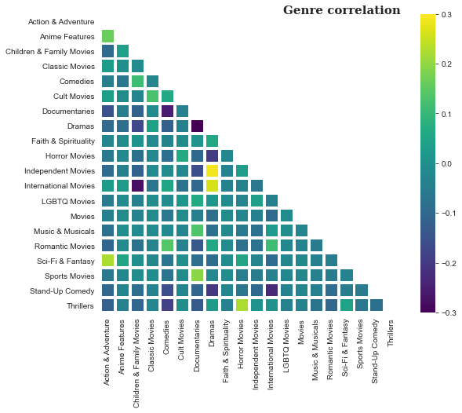
Correlation between Genres
Correlation between genres can reveal interesting insights.
People who tend to like one genres may be interested in similar genres
For example, Sports and Documentaries are highly correlated
Similarly, Independent movies are also more tend to be dramas
Netflix should prioritize similar genres and provide tailor made recommendation

Slide 28
Conclusion
Section 3

Slide 29
Conclusion
Proper content strategy can increase user engagement level
As most people binge-watching, Netflix should constantly add more contents
Netflix should release right content at right time. Ideal months are December and January. Ideal day should be Friday
Netflix should produce region specific contents
Potential opportunity in Kids level content

Slide 30
Caution and Discussion
This analysis only analyze content available on Netflix
These recommendation should be combined with other analytics
Netflix should use internal data (user engagement, demographic, revenues etc.) along with these recommendation
Analysis does not include contents that were added and removed from Netflix. Further quality check should be performed before implementing suggested strategy

